Slide 1

Game Ideas Pitch

Slide 2
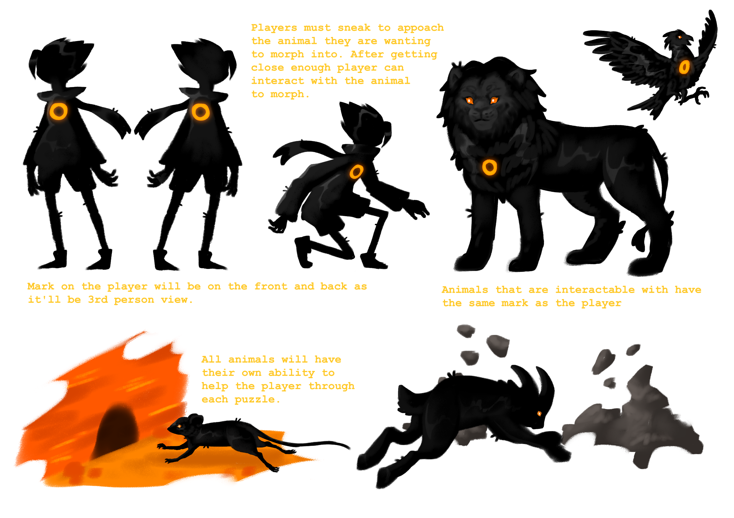
Morph - Puzzle Game
An linear outdoor dungeon style game with multiple puzzles.
Puzzles must be solved using the unique abilities each animal has, may it be digging, small body size, strength or flight.
Each puzzle area will have the animals needed to complete it, it’s up to the player on how they use them.
Details:
Will be small collectables on the way through.
Text based narrative.

Slide 3
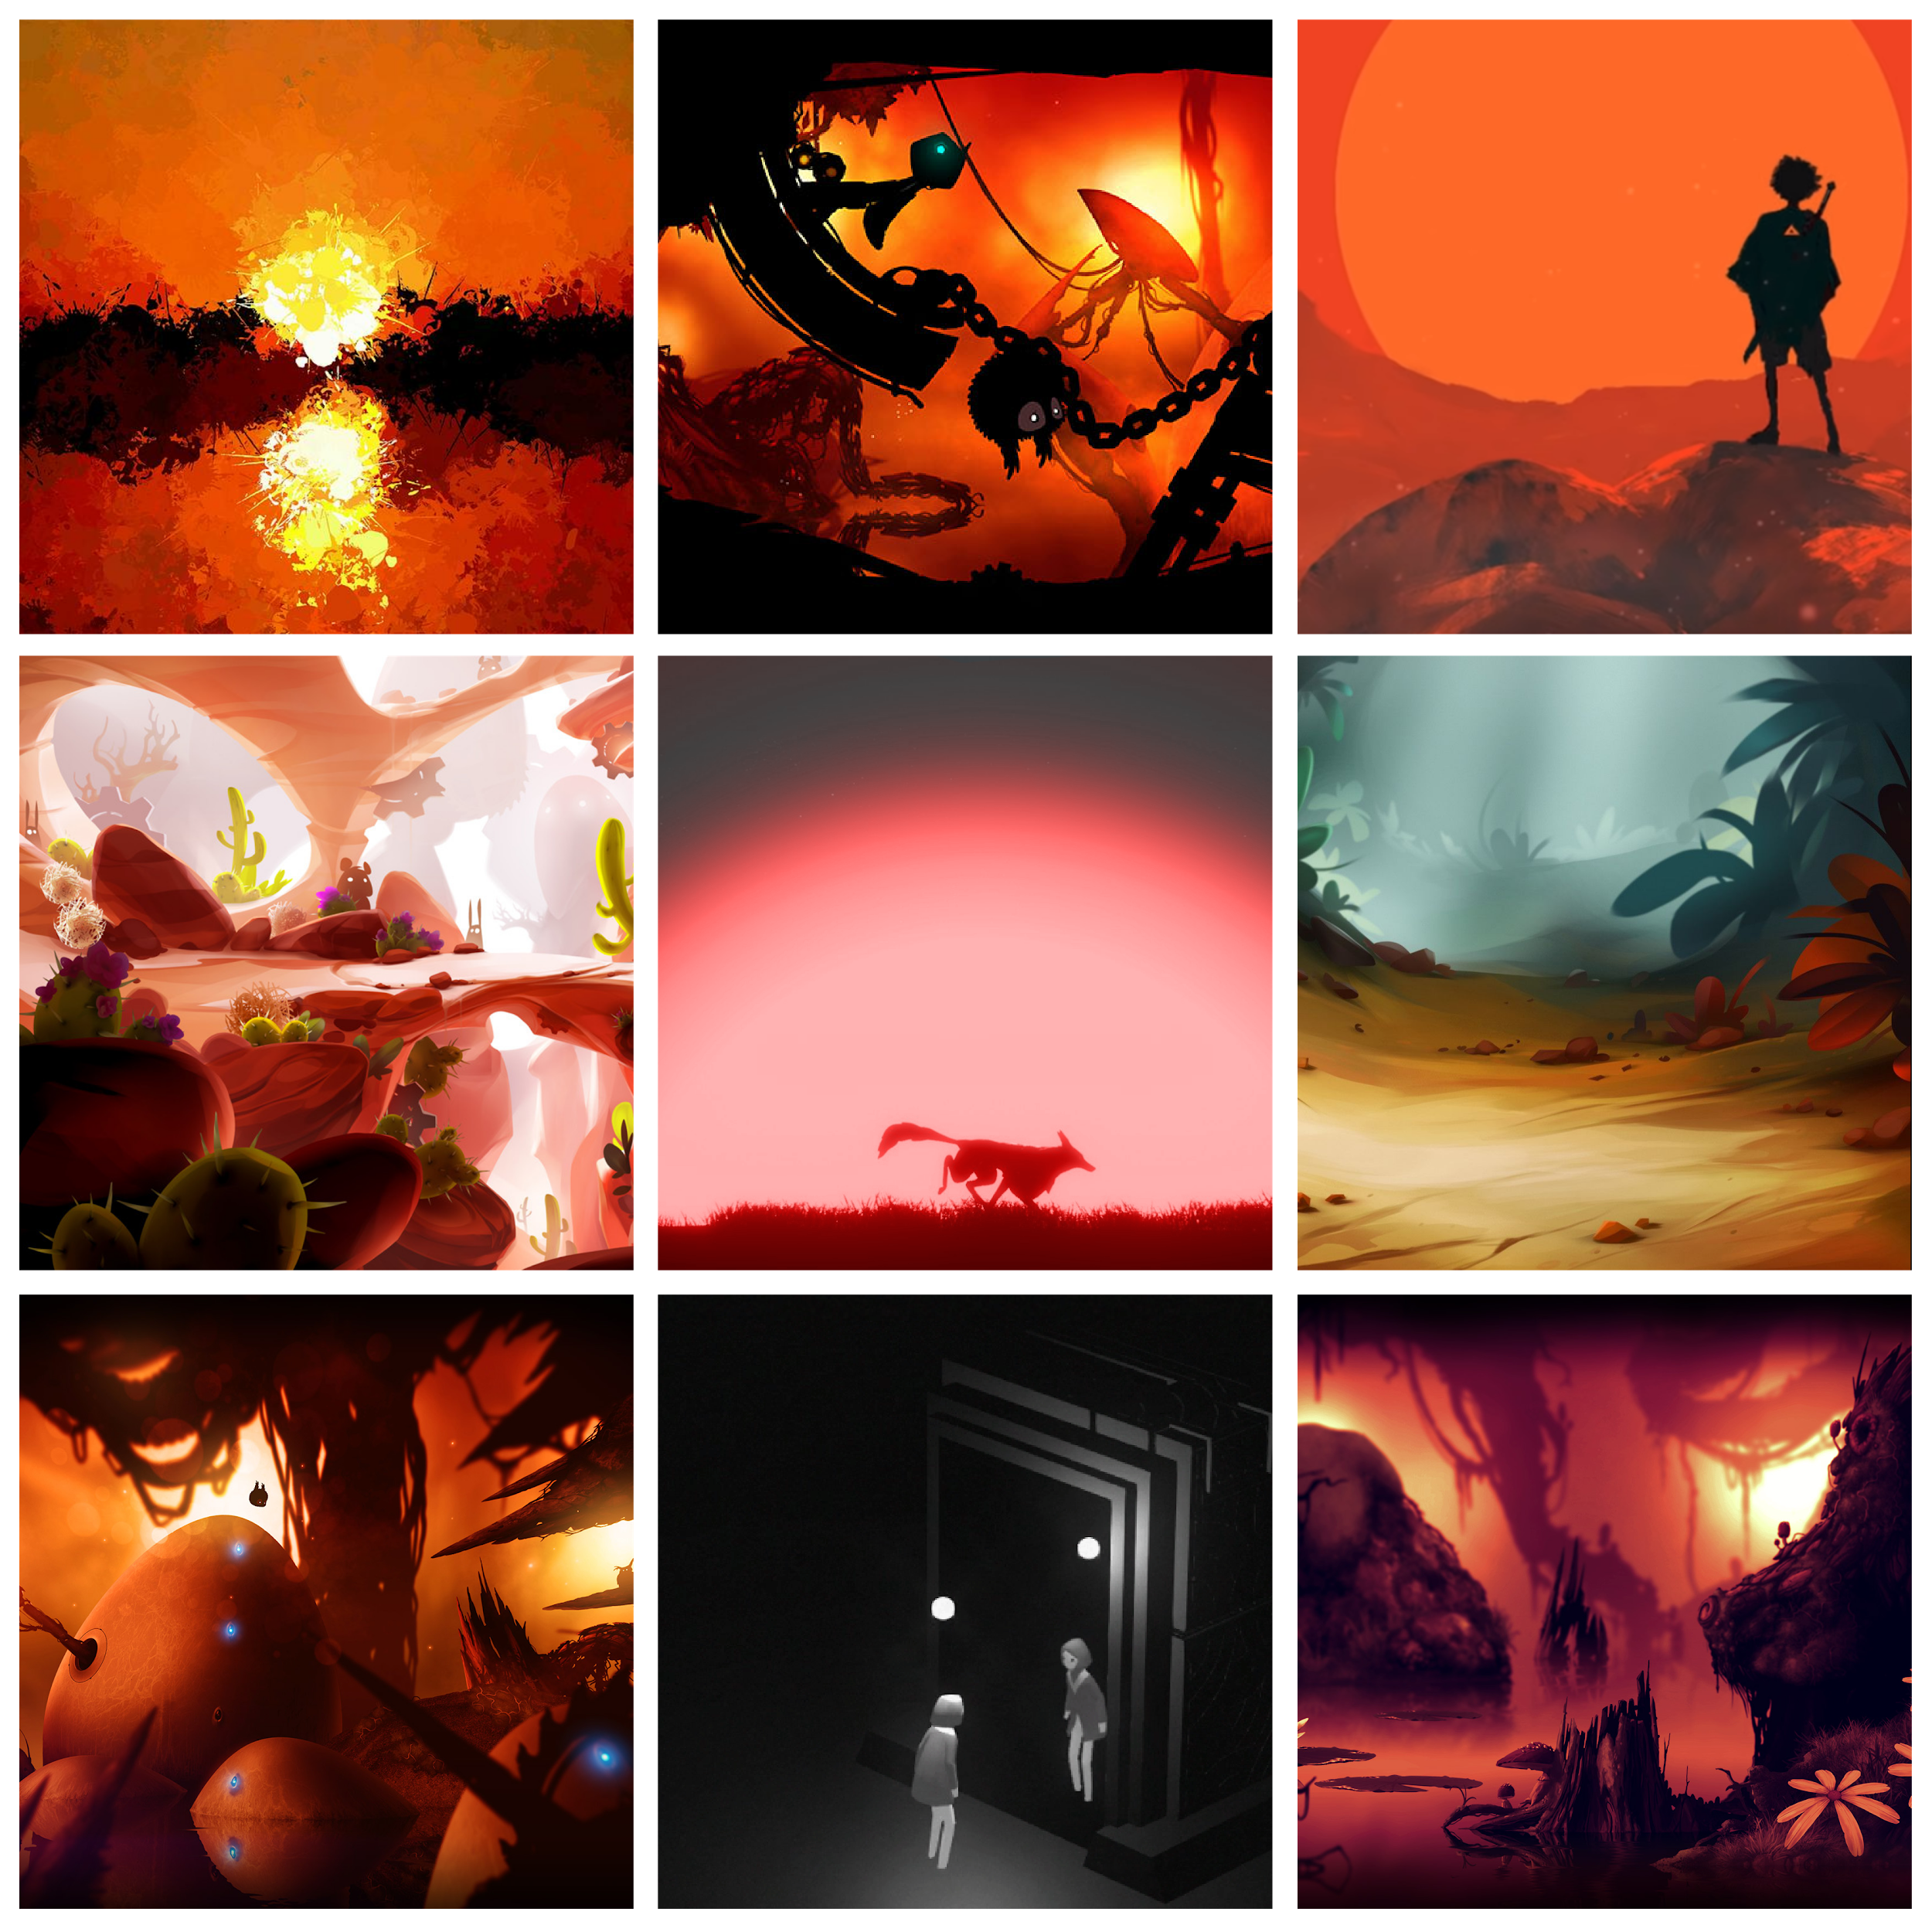
Moodboard/Style/palette
Going for a sorta monochromatic style, with black-ish silhouette as the animals and player.
Not overly realistic, toonish smooth style.
3D world, and 3rd person view for the player.

Slide 4

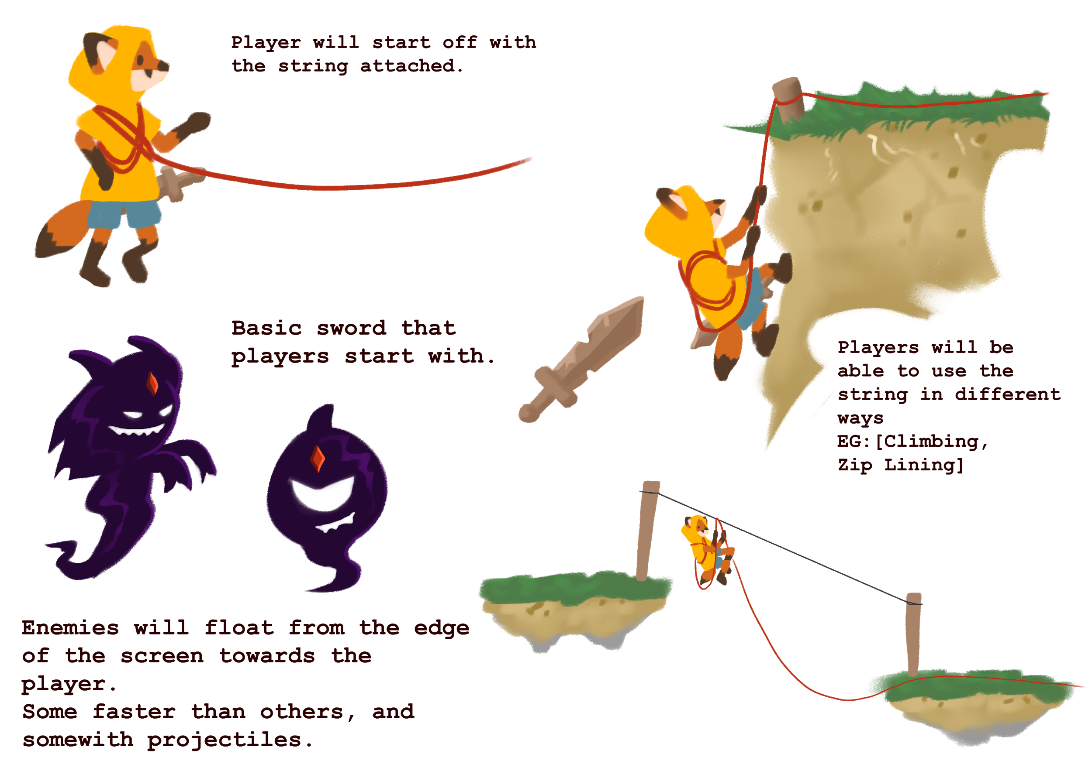
String of Fate - Combat Platform Game
Side scroller combat platform game.
Players must adventure to find the end of the string. Being hit by an enemy will cause the string to fade as its counted as your health bar. Health will regen back slowly, and string will reappear. If string completely disappears the connection is lost and your player dies.
Player starts off with a basic sword, and gains more skills and weapons throughout the journey.

Slide 5
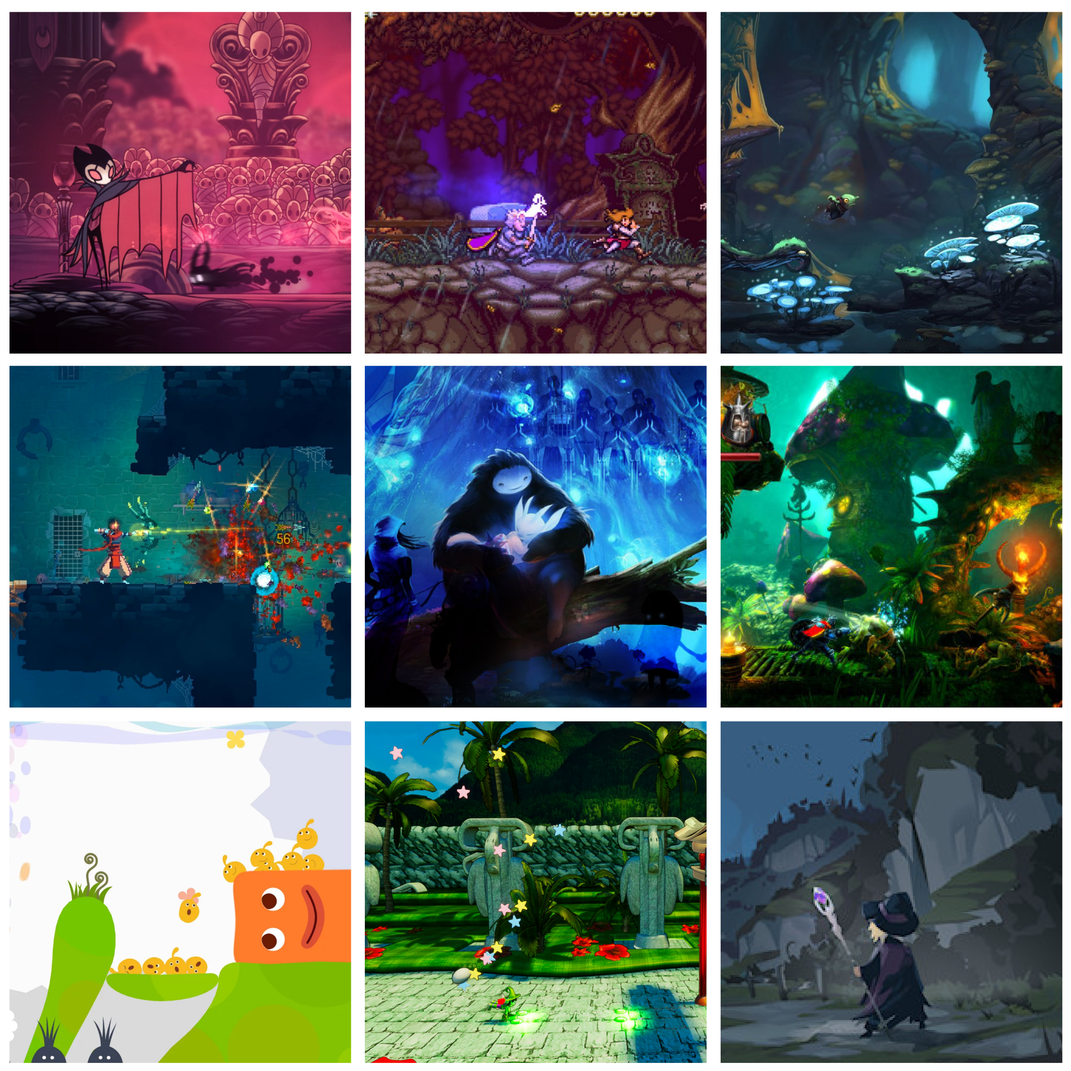
Moodboard/Style/Palette
Bit more green and blue palette for the string to stand out.
Will be corrupted areas of the map that’ll be dark-ish purple.
Going for very simple toony style, with bit of rustic painting brush.

